Slide 1
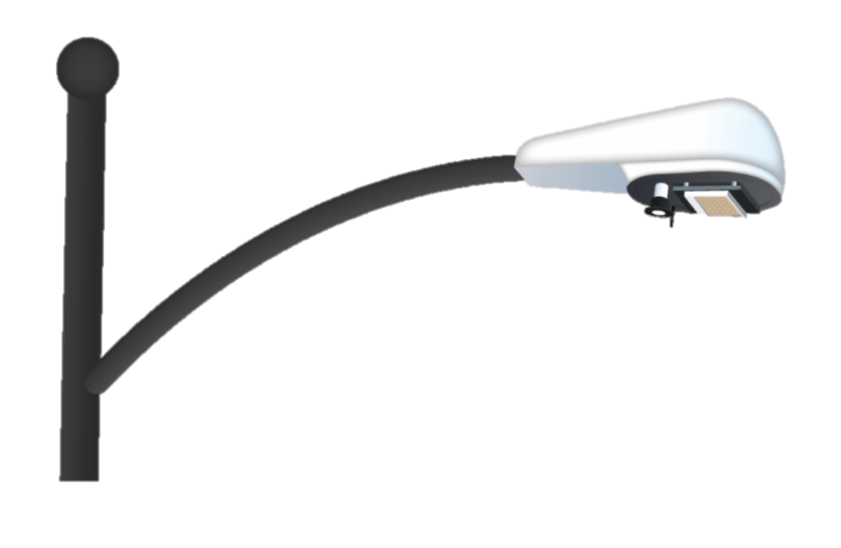
Smart LED Street Lights Connected to Centralized Control & Monitoring Systems (CCMS)
Presented by
Hackstreet Boys

Slide 2


What are the challenges?
Fault Detection and Improving the Monitoring Service
Predicting faults (if possible) before they occur
TO DETECT/IDENTIFY THE DEFECTIVE/NON-FUNCTIONAL LIGHTS
PRESENT CONSUMER COMPLAINT DATA TO BE ANALYSED FOR PREDICTIVE ANALYSIS OF THE FAULTS

Slide 3
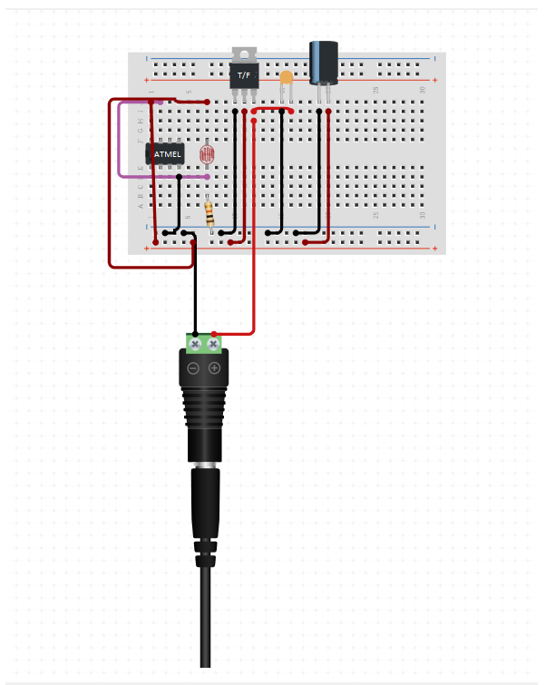
#1 Detecting Faults and Improving Monitoring Services
An LDR Sensor is used with Microcontroller Atmel 93C46 at every node. This provides digital data corresponding to the status of individual units.
RF transmitters and receivers are used to for transmitting and receiving digital data through an array of units.

Slide 4
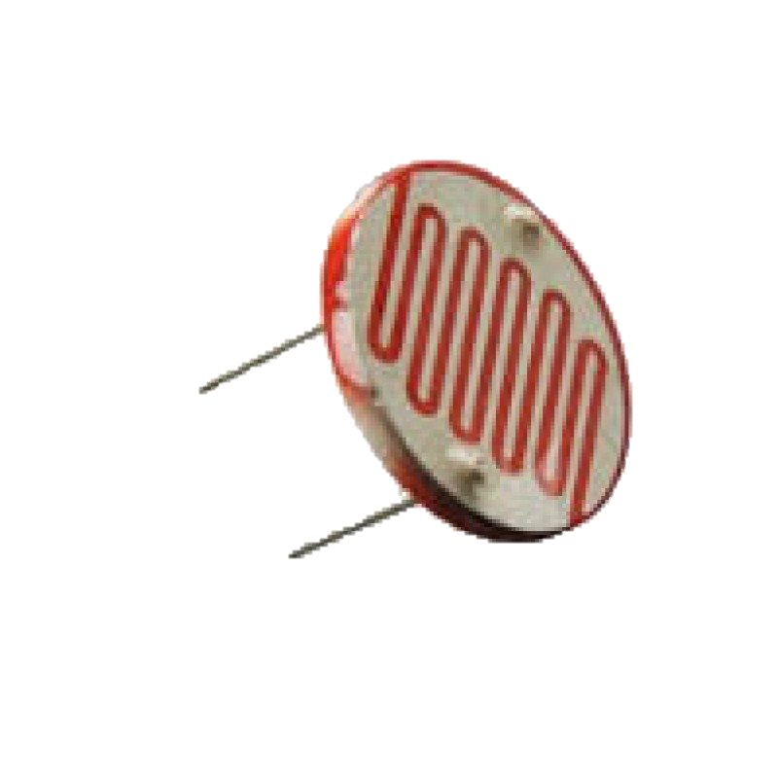
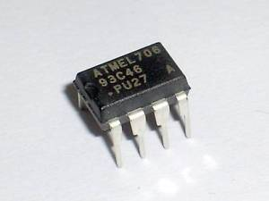
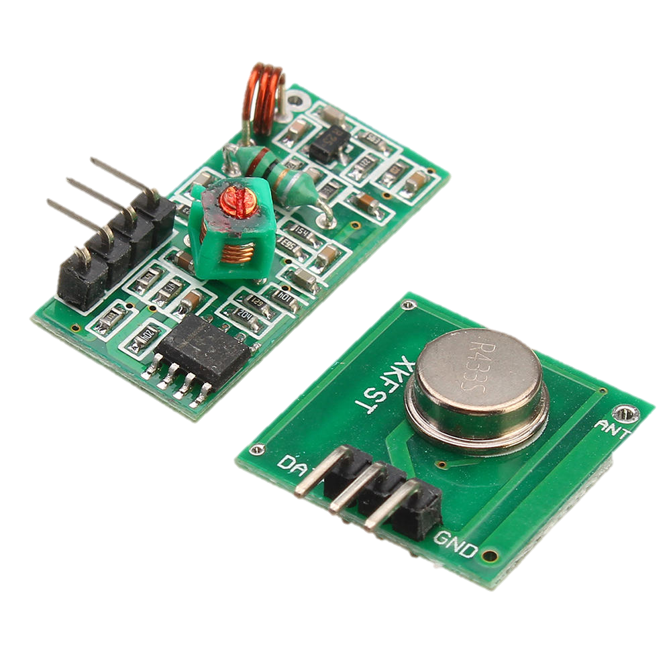
Business Model and Feasibility
Cost Incurred to Improve Present Nodes for Fault Detection
1
LDR Sensor: ₹1.60
2
Atmel 93C46 Microcontroller ₹ 6.00
2
RF Transmitters & Receiver ~₹ 1.00 each
Total Cost of Upgrade < ₹10
Cost can be further reduced on bulk production

Slide 5



#2 Predictive Analysis of Consumer Complaints
A TensorFlow Machine Learning Unsupervised Model that clusters the following features
Latitude and Longitude of Malfunctioning Node: Obtained from MapQuest API from address
Time Stamp : Time Window of Fault
Historical Meteorological Data: Obtained from Dark Sky API
Electrical Parameters
Type of Fault
1
2
3
4
5

Slide 6

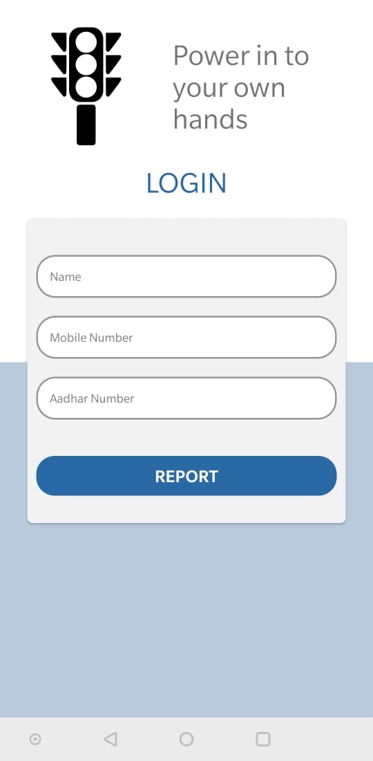
#3 Consumer Complaint Portal
An Android application that provides the users with a mobile android application to register complaints.
Tech Features:
Register Complaint with Aadhar Details, Address and Unit ID
Check status of requests/ complaints generated
1
2

Slide 7
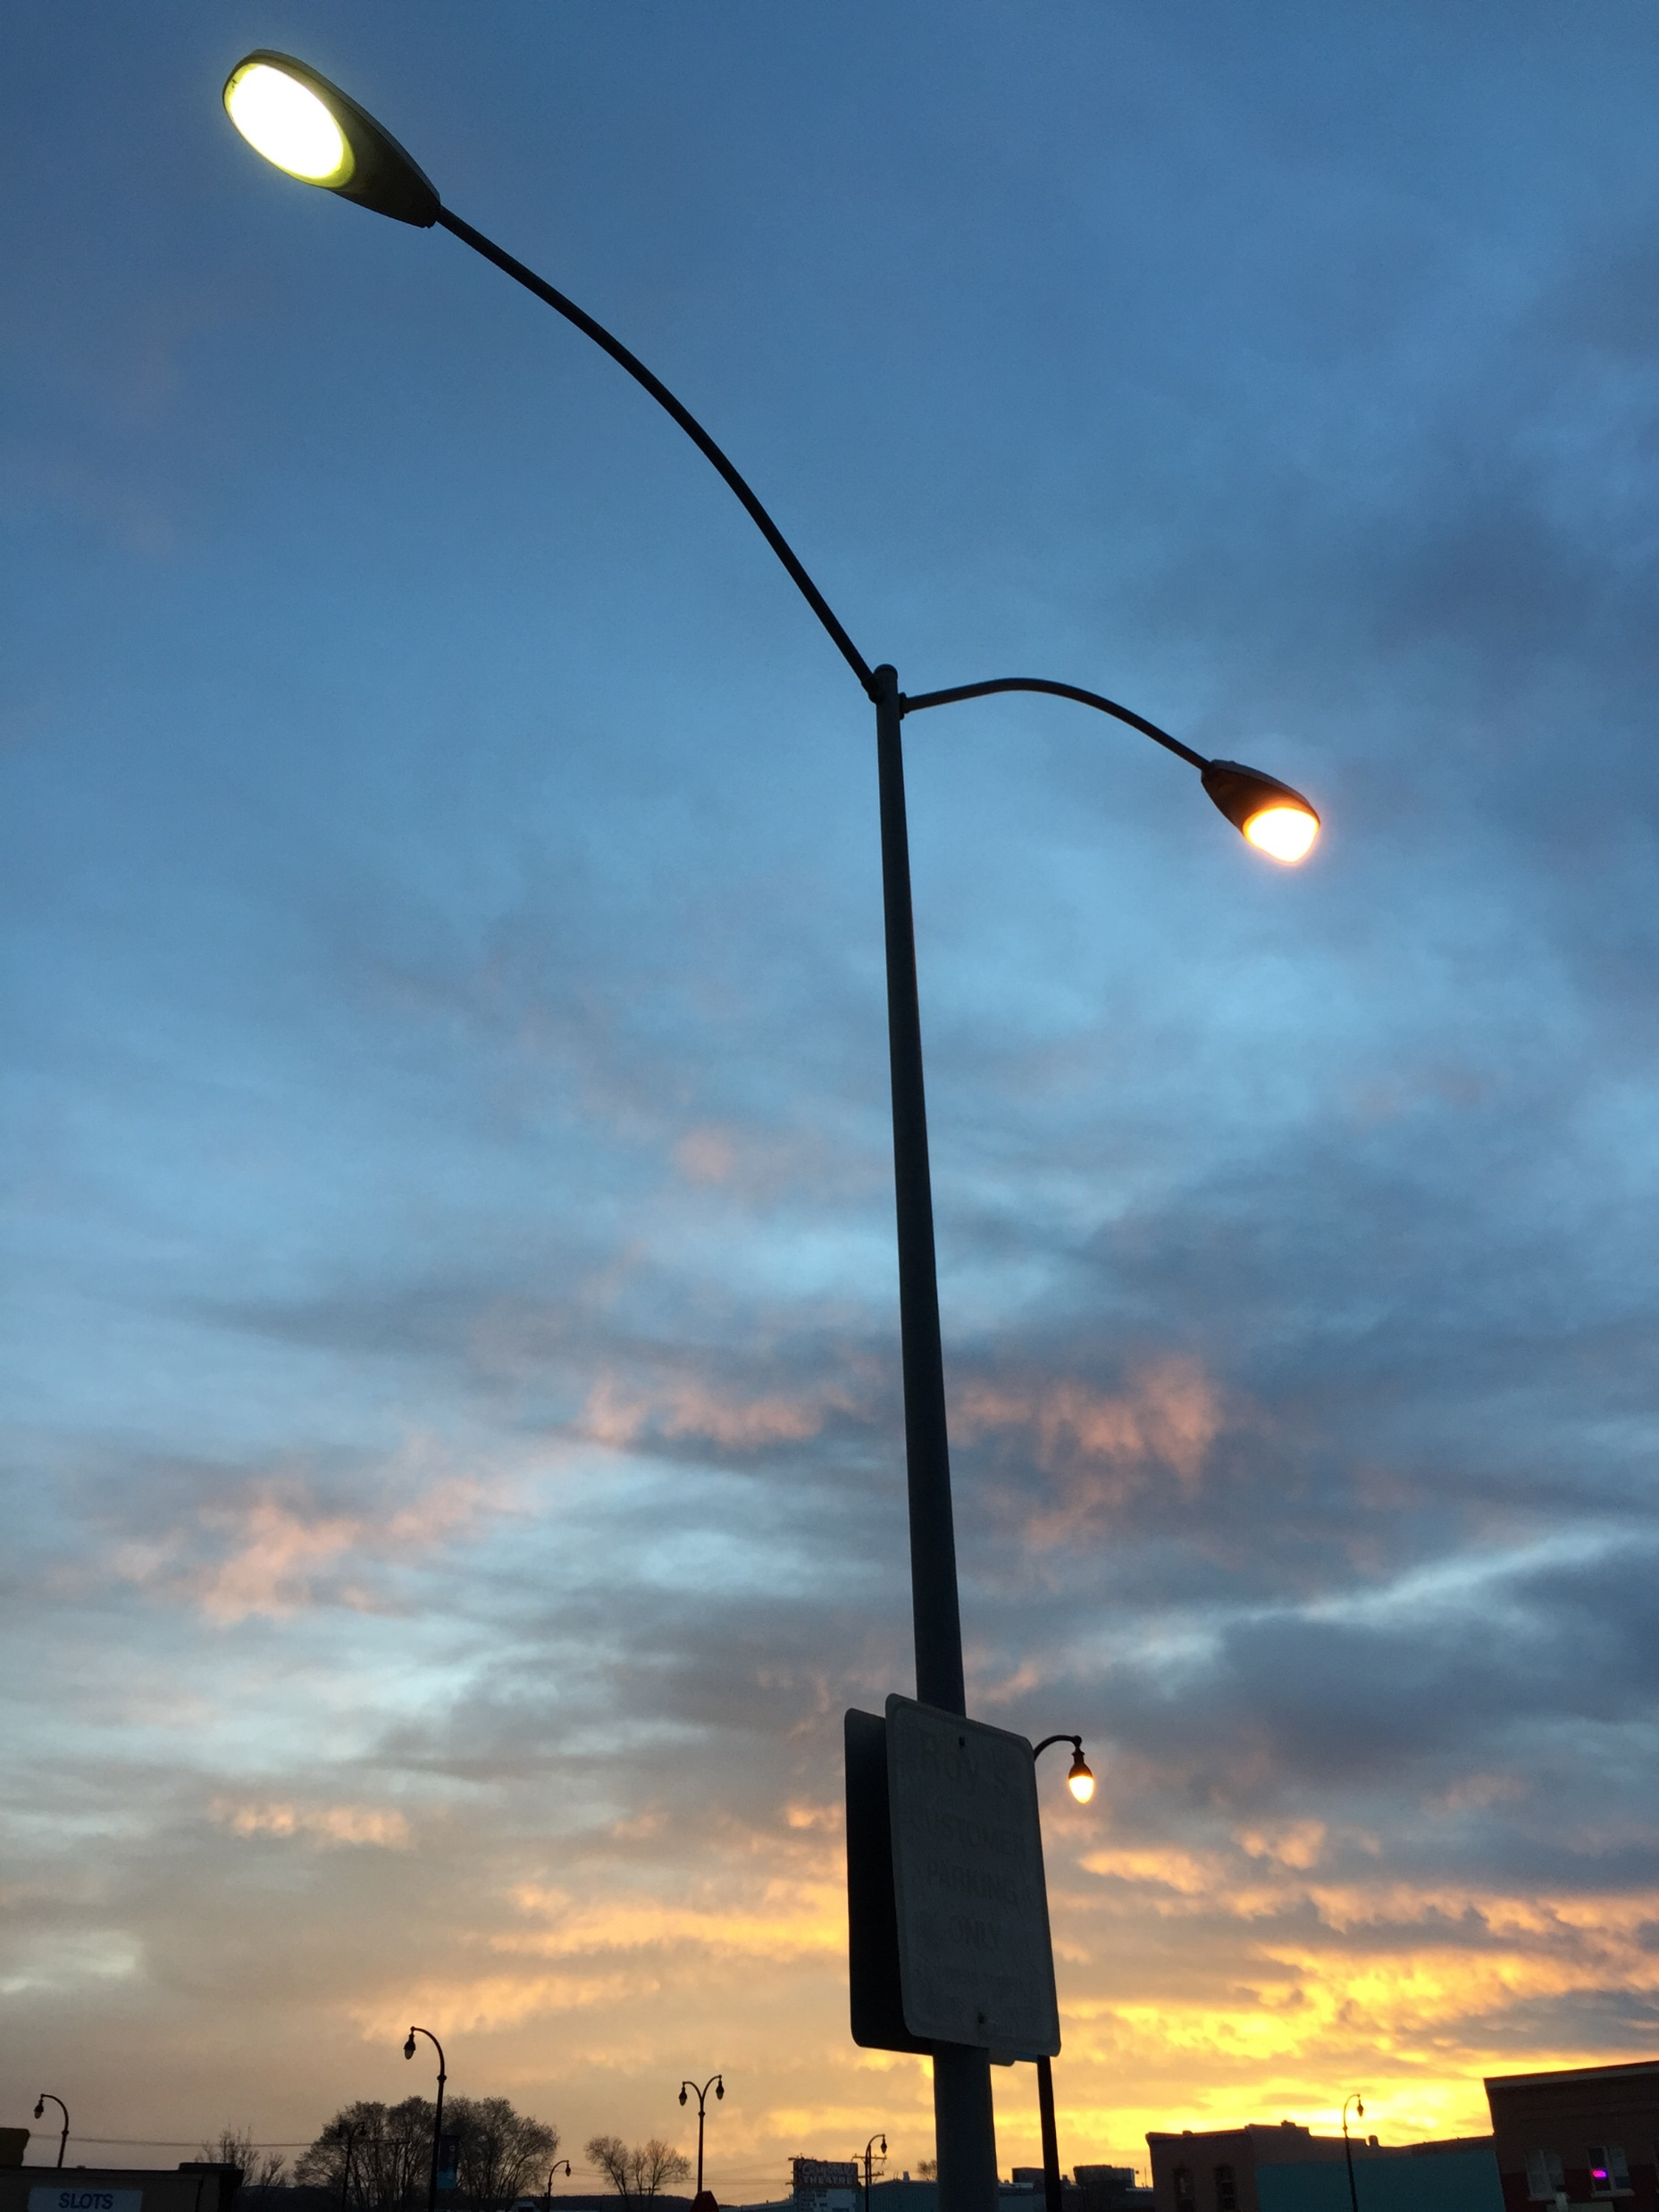
Thank You!
Presented By:
JOYENDRA ROY BISWAS
KARTIK MADAN
PARTH CHOPRA
SHUBHAM KACHROO

